Slide 1
3
Case Study in Personas
PRESENTED BY Group 3

Slide 2

PART 1
Introducing the Idea of Personas
1

Slide 3

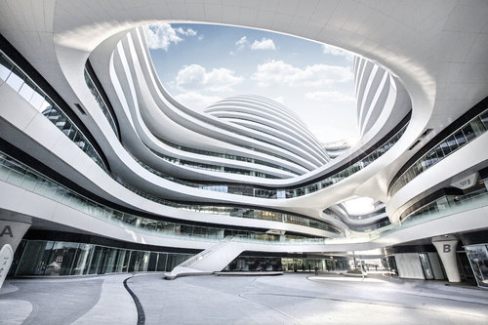


Current Situation of ClickDox
Recognized the opportunity about exchanging documents over the Internet with complete security
Having done 8 focus groups, getting some customers’ reactions to the idea of ClickDox
Established by a group of IT experts who’d worked together in the document management industry
Within 2 years they wanted to sell the business to a major courier
Knowing that the best technology means nothing if people don’t want to use it.
FedEx and UPS are mature companies with mature markets. For ClickDox to appeal to them, the technology will have to serve customers—not the other way around.
2

Slide 4
High-level Questions
to Understand the Usage of the User Study
and its Relationship with the Business Goals
Who exactly are ClickDox’s customers? What can you tell me about them?
What activities will customers perform on the ClickDox website? Which are most important?
What impact will the website have on ClickDox’s business?
What challenges do you expect we’ll face in this project?
How will you know if this project is successful? What can we measure?
What really excites you about ClickDox overall?
--- A wide range of answers from the stakeholders!
Need to collect richer information about customers’ goals and actual behaviors around exchanging documents.
3

Slide 5
Personas
Definition
Personas are composites that represent significant patterns across groups of customers.
Characteristics
Personas actually look like descriptions of real people, containing lots of information.
Format
Many personas include a name, a photo, a few high-level goals, a representative quote or two, a story that describes the person, and a few short lists with additional facts.
4

Slide 6
Advantages of Personas
This format engages people, helping them to empathize with customers.
Get value beyond the plain facts: When a character is well defined, we’re able to predict how that person might behave in new situations.
Without understanding customers at this level, it will lead to decisions based on how committee would imagine using the product themselves.
5

Slide 7
What are people’s overall job goals?
By understanding what fundamentally motivates people, we can design ClickDox’s website so it helps them achieve something important.
What to Expect？
What’s the context in which they’d use ClickDox?
By understanding the many factors that influence people on the job, we can design ClickDox so it feels like it was made just for them.
What are their current behaviors around document exchange?
By understanding how people get things done today, we can design ClickDox to help them do it better.
6

Slide 8
Question 1,2 & 3
When is it appropriate to create personas for a project?
What kind of information should personas contain?
How could Joanne, Greg, and Roberta set up this project for success, especially knowing there are skeptics at ClickDox?
At the early stage of developing a product, when matters including reaching consensus among group members about the high-level goals and perceptions about the products, understanding customers’ real needs and their actual behaviors are important.
Many personas include a name, a photo, a few high-level goals, a representative quote or two, a story that describes the person, and a few short lists with additional facts.
First of all, they should make the team aware of the importance of understanding the users. They should make a wise plan, trying to reach the desired goals using resources as few as possible. The product developing management should also be modified, and not only focus on the speed and technical points, but also try to consider real users.
7

Slide 9
PART 2
Planning the Field Research
8

Slide 10
Prior Considerations
There are two key groups of people within each of these industries: those who will actually use ClickDox and those who will support it.
Try to Minimize the Time
Assumptive personas:
personas based entirely on information gathered from existing research—and from people’s opinions inside the organization.
The drawback is they won’t be as rich and may not reflect reality.
Decide which industries to focus on: civil engineering and architecture
Are any of these customers particularly good or bad targets for some business reason?
Would any of these customers impose requirements that are exceptionally unique to their needs?
On the other hand, would any of these customers be a strong “proving ground” for the product concept?
9

Slide 11
The Field Research Plan
Week | Activity | Notes
1 | Plan and recruit participants | 20 in total (12 end users/ 8 IT supporters) from 4 companies in 2 cities. Offering an opportunity, not asking for help.
2 | Conduct the field research | 2 research teams with 2 people each, and switch up regularly
3 | Analysis and creation of the personas | Don’t necessarily believe what people say they do
4 | For contingency
10

Slide 12
Research Topics
Shipping practices
Electronic file exchange
What are the various means by which
you send and receive documents? (observe)
What kinds of files do you exchange with other people electronically?
(Obtain samples if possible)
How do you decide whether to ship electronically, by mail, by
courier, or by some other means?
Let’s walk through the process of how you send a document electronically.
(You could create a scenario by offering your business card and asking them to send you something)
11

Slide 13
Question 4 & 5
What ideas can you think of for reducing the time or money required to perform this research?
If you were conducting research for personas, what general topics would you explore with participants, regardless of the product domain? Provide some example questions for each.
Reduce the number of participants:
Find the most representative participants.
Recruit the minimum effective sample size.
Make the interviews efficient and effective:
Prior research may be needed.
Orientation, training, rehearsal and refinement are expected.
Follow the standard procedures while conducting the interviews.
Check with the participants before the formal interview.
Reduce travel money:
Arrange the routes and choose the travel method wisely and economically.
Something regarding the person directly
Some general demographic background information, education level and career background.
How would your peers describe you?
Who is your idol?
Personal shopping behaviors
How do you usually make purchases? Online or offline?
How do you decide which product to buy?
Potential user pain points
Describe a general day of yours.
Are you content with your day? Which part is the most frustrating? How will you react to it?
12

Slide 14
PART 3
Conducting the Field Research
13

Slide 15
Interview Procedure
The ﬁrst day was bit rough for Dimitri, as he tended to inﬂuence participants with his comments and questions, so Greg had needed to explain.
Yoko was a terriﬁc person to interview, but Yoko seems to match their idea of an ideal customer. Roberta gave her a business card, Yoko opened Microsoft Outlook, created a new message, addressed it to her, and attached a PDF of the building plans.
Secure FTP server set only times she uses it is when a ﬁle is larger than 5 MB, which is their limit for attachments, so does everyone else, a textbook example of the difference between what people say and what they do.
14

Slide 16
The contribution of personas and the interview
The personas helps the designer to get a deeper understanding of the customer.
Greg criticized Dimitri of him being too honest about his thoughts, but Greg thought the same thing except he tried to ignore the presence, pretending to agree with an unsatisfying product.
Yoko was also being honest about her thoughts on the FTP security, knows that it is important to secure, but on the real circumstance, she does not use it, because email is much easier to use and of the limitation of the file’s size. Also, she does not believe someone would get their hands to a restaurant plan.
Point being, people use and wants things they “really” need for.
15

Slide 17

Question 6 & 7
What if you just don’t hit it off with a participant and can’t seem to establish rapport?
You’ve just started an interview with a participant. They showed up with a list of wishes and complaints about the product you’re working on—and they only want to talk about that. How do you respond?
As a interviewer,
Dimitri: Being honest, criticize
Greg: Tries to be friendly
I would listen carefully and answer the wishes and complaints, then explain the circumstance that we are in, behaving politely as possible. Simple as it is.
16

Slide 18

Question 8
The research team feels a pattern is emerging: that people don’t care about security as much as they were led to believe. How might they further explore and possibly conﬁrm this in future interviews?
As they proceed,
Ask straightly of security and ask a circumstance where speed is more important, which is the biggest reason of email usage.
Ask how they think of the daily email (such as Yahoo, Google, etc.), then decide whether or not to ask about the security.
Roberta asked as carefully as she could to not offense Yoko and found the very classic persona. Being polite is the most important part of the asking, Roberta probably will keep it her way.
17

Slide 19
PART 4
Developing
the Personas
18

Slide 20
Process of Surfacing Patterns and Identifying Personas
Step 1
Compile a master list of observations
Step 2
Arrange Observations Into Categories
Step 3
Identify Findings in Each Category
Step 4
Cluster the Findings into Coherent Groups
Capture only those things that are critical to understanding what makes participants tick.
Look for items that represent people’s overall goals to create categories about the same topic.
Identify the specific findings that eventually make up personas.
Cluster findings into groups belong together of goals, of context, of behavior.
19

Slide 21
Develop the Groups into Full Personas
——Additional Insight
Primary persona
Secondary persona
Supplemental persona
Someone who would be unsatisfied with a product designed for anyone but them. The intention would be to design ClickDox first and foremost for this persona.
Someone with unique characteristics but who
would not be unsatisfied using the primary persona’s product. The
intention would be to accommodate their needs, but not at the
expense of the primary persona.
Someone whose needs deserve consideration
but who’s not clearly a target.
20

Slide 22
The Final Personas
Timothy Powell
Madeline Deville
Jim Temaki
Wants to get things done.
Wants to be in control and confident of what’s happening at all times.
Would be happy with more security, but values convenience more.
Uses e-mail as a detailed archive of project activity.
Uses FTP to exchange files too big for e-mail.
Strives to be seen as indispensable to customers.
Is more concerned about quality than deadlines.
Sends documents by courier when they’re too big for e-mail.
Really doesn’t care about security.
Has limited computer skills outside AutoCAD.
Strives to save money for the organization.
Held accountable for downtime due to technical issues.
Cannot plan ahead. “Fights fires” all day.
Loves the challenge of juggling priorities.
Has a dedicated e-mail account for IT emergencies.
21

Slide 23
Question 9
During the course of your analysis, you discover that some data are missing. You failed to collect observations about an important topic from every participant. What do you do?
Listwise Deletion
Hot deck Imputation
In statistics, listwise deletion is a method for handling missing data. In this method, an entire record is excluded from analysis if any single value is missing.
The technique finds the first missing value from an ordered database by a variable and uses the cell value immediately prior to the data that are missing to impute the missing value.
Mean Imputation
Expectation Maximization
The missing observations will be imputed by the mean value of other observations conditioned or unconditioned.
The EM iteration uses the other observations to compute the mean value and other parameters to impute the missing value. Then the new observation set is used for further imputation.
22

Slide 24

Question 10
Do your personas have to account for every observation you collected?
NO ! ! !
Reasons:
Compiling of master list focus on critical factors ignoring some characteristics.
Some interesting details play little part in deciding personas.
A personas is abstracted from observations instead of existing human.
23

Slide 25
Question 11
How many primary personas will you have?
Only One ! ! !
Reasons:
If there are two primary personas, according to the definition, the product cannot be accepted by both personas then we need to decide which one will be our primary personas.
Primary personas defines the product design. The diversity in primary personas can cause ambiguity in product objectives and functions.
24

Slide 26
PART 5
Living With the Personas
25

Slide 27
Presentation of the finding
The following Wednesday, Joanne, Dimitri, Greg, and Roberta stood before most of the ClickDox team to present their ﬁndings.
Joanne opened the discussion by introducing the project. Greg and Roberta then gave an overview of how they’d analyzed the research. Finally Dimitri took the ﬂoor
Dimitri introduce 3 personas - Timothy Powell and the other two. “But I’m glad we did this research now, because I feel we know something important about the market that our competitors don’t. And that’s good news”
26

Slide 28
The contribution of personas and the presentation
The personas helps the designer to get a deeper understanding of the customer. And the goal of ClickDox has also changed:
website plug-in of MS Outlook
After the presentation, there was a noticeable shift in perspective in the following weeks among ClickDox teams - the personas were helpful in getting people to agree with each other.
27

Slide 29
Challenges in future
Installation
Making the installation process as simple and friendly as possible while satisfying the demands of an IT department
Payment
Joanne was getting concerned about feedback from some participants that they wouldn’t expect to pay anything for the service
. . .
? ? ?
28

Slide 30
Question 12
In what other ways might the personas make contributions?
Precision marketing: Analyze the potential users of products
User statistics: Summarize the using information of users
Data mining: Build the intelligent recommendation system
Effect evaluation: Improve product operation level and service quality
Personal Tailor: Personalized service
Competitive analysis: Influence enterprise development strategy
29

Slide 31
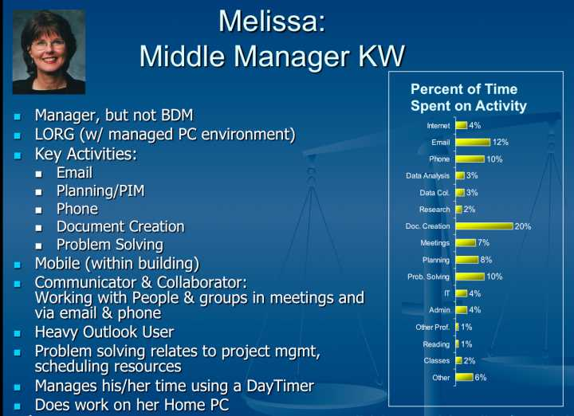
Question 13
What ideas could you imagine for helping the people at ClickDox become familiar with the personas and keep them in mind when making decisions?
Post the personas of the staff in the wall around in office, which include some basic information, hobits and other nonprivate things ~
30

Slide 32
Group 3
THANK YOU

